Slide 1
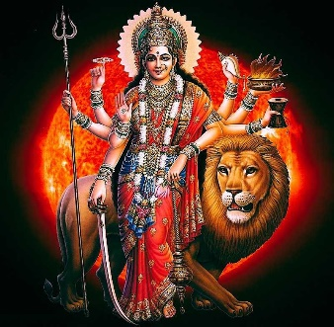
DURGA PUJA FESTIVAL - 2022
IFFCO TOWNSHIP PARADEEP
Date | Competition |  | Venue | Time | Eligibility
01.10.2022 Saturday (MAHA SHASHTEE) | MYTHOLOGICAL QUIZ (Prizes on spot) |  | COMMUNITY CENTRE | 17:45 - 19:00 | ALL RESIDENTS OF IFFCO TOWNSHIP
02.10.2022 Sunday (MAHA SAPTAMI) | CHANTING OF “OM” |  | PUJA MANDAP | 17:45 - 19:00 | LADIES & GIRLS GENTS & BOYS
03.10.2022 Monday (MAHA ASHTMEE) | DHUNUCHI DANCE |  | PUJA MANDAP | 17:45 - 19:00 | LADIES & GIRLS GENTS & BOYS
04.10.2022 Tuesday (MAHA NAVMEE) | SANKH BADAN (Participants shall bring their own Sankh) |  | PUJA MANDAP | 17:45 - 19:00 | LADIES & GIRLS GENTS & BOYS
05.10.2022 Wednesday (VIJAY DASHMEE) | FANCY DRESS ON ANY MYTHOLOGICAL CHARACTER |  | PUJA MANDAP | 10:00 – 11:00 | GIRLS & BOYS WITH AGE GROUP 03-08 YEARS
15.10.2022 Saturday | CULTURAL PROGRAMME |  | COMMUNITY CENTRE | 18:00 ONWARDS | ALL RESIDENTS OF IFFCO TOWNSHIP
 | PRIZE DISTRIBUTION |  |  |  | ALL WINNERS

Slide 2
DURGA PUJA FESTIVAL - 2022
IFFCO TOWNSHIP PARADEEP
Date | Description | Time | Aarti & Pushpanjali | Prasad Distribution
01.10.2022 Saturday (MAHA SHASHTEE) | (BILWA ADHIBAS) INAUGRATION OF MANDAP | 15:11 – 17:58 19:00
02.10.2022 Sunday (MAHA SAPTAMI) | KALASH YATRA NABAPATRIKA PRABESH PRANPRATISTHA, SODASHA UPACHAR, CHANDIPATH & HAVAN. | 07:00 – 09:37 09:37 onwards | 12:30 & 19:00 | 13:00 & 21:30
03.10.2022 Monday (MAHA ASTAMEE) | SANDHI PUJA, BALIDAN, SODASHA UPACHAR PUJA ARATI,PUSPANJALI & BISHRAM | 7:00 – 16:14 16:38 – 17:02 | 13:00 & 19:00 | 13:30 & 21:30
04.10.2022 Tuesday (MAHA NAVAMEE) | CHANDIPATH, SAPTA-SATI CHANDI AAHUTI, SODASHA UPACHAR PUJA AARTI,PUSPANJALI, SANTIPATH & BISHRAM | 07:00 – 14:00 16:30 Onwards | 13:00 & 19:00 | 13:30 & 21:30
05.10.2022 Wednesday (VIJAYA DASHAMEE) | APARAJITA PUJA, HAVAN,AARTI,PUSPANJALI VISARJAN | 07:00 - 14:00 | 12:30 | 13:00
 | SINDURKHELA | 14:00 – 16:00
 | IMMERSION CEREMONY | 16:00 onwards

