Slide 1
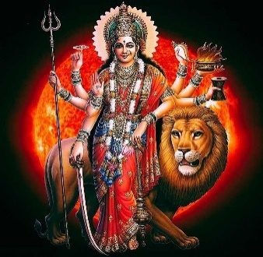
DURGA PUJA FESTIVAL - 2024
IFFCO TOWNSHIP PARADEEP
Date | Description | Time (Hrs) | Aarti & Pushpanjali | Prasad Distribution
09.10.2024 Wednesday (MAHA SHASHTHEE) | BILWADHIBASA INAUGRATION OF PUJA MANDAP | 15:05 – 17:50 | INAUGURATION 18.00
10.10.2024 Thursday (MAHA SAPTAMEE) | KALASH YATRA, NABAPATRIKA PRABESH SURYA PUJA,MANDAL PUJA,CHAKSHU DAN,AGNI STHAPAN SODASHA UPACHARA PUJA, CHANDI PATHA, DEVI SUKTAM, HAVAN | 05:30 – 06:29 08:00 – 09.36 10:00 - 18.30 | 13:00-13.30 & 18:30-19.00 | 13:30 & After Arati at Navaratri venue
11.10.2024 Friday (MAHA ASHTAMEE) | MANGALA AARTI SURYA PUJA, SODASHA UPACHARA PUJA CHANDI PATHA, DEVI SUKTAM, HAVAN SANDHI PUJA | 06:00 07:00 – 08:00 08:30 – 09:36 10:00 - 18:30 11.43 - 12.31 | 10.30-11.00 & 18:30-19.00 | 13:30 & After Arati at Navaratri venue
12.10.2024 Saturday (MAHA NAVAMEE) | MANGALA AARTI SURYA PUJA SODASHA UPACHARA PUJA, CHANDI PATHA, DEVI SUKTAM, HAVAN SAPTASATEE CHANDI AHUTI | 06:00 07:00 – 08:00 08:30 – 09:36 10:00 -13:00 16:30 – 18:30 | 13:00-13.30 & 18:30-19.00 | 13:30 & After Arati at Navaratri venue
13.10.2024 Sunday (VIJAYA DASHAMEE) | MANGALA AARTI SURYA PUJA UPACHARA & APARAJITA PUJA, HAVAN,AARTI,PURNAHUTI PUSPANJALI, GHATA VISARJAN | 06:00 07:00- 08:00 09:00 – 13. 47 | 12:30-13.00 | 13:30
 | SINDURKHELA | 14:00 – 15:00
 | IMMERSON CEREMONY | 16:00 onwards

